Slide 1
Queries, Database Design, Constraint Enforcement
Specify Schema + specify constraints. Implementation: SQL commands (assert, check, trigger, key)
Input information = process transactions + check constraints.
Query Tables.
Implementation: SQL “SELECT”

Slide 2
Overview of Storage and Indexing
Chapter 8
“How index-learning turns no student pale
Yet holds the eel of science by the tail.”
-- Alexander Pope (1688-1744)
Notes:
1
The slides for this text are organized into chapters. This lecture covers Chapter 8.
Chapter 1: Introduction to Database Systems
Chapter 2: The Entity-Relationship Model
Chapter 3: The Relational Model
Chapter 4 (Part A): Relational Algebra
Chapter 4 (Part B): Relational Calculus
Chapter 5: SQL: Queries, Programming, Triggers
Chapter 6: Query-by-Example (QBE)
Chapter 7: Storing Data: Disks and Files
Chapter 8: File Organizations and Indexing
Chapter 9: Tree-Structured Indexing
Chapter 10: Hash-Based Indexing
Chapter 11: External Sorting
Chapter 12 (Part A): Evaluation of Relational Operators
Chapter 12 (Part B): Evaluation of Relational Operators: Other Techniques
Chapter 13: Introduction to Query Optimization
Chapter 14: A Typical Relational Optimizer
Chapter 15: Schema Refinement and Normal Forms
Chapter 16 (Part A): Physical Database Design
Chapter 16 (Part B): Database Tuning
Chapter 17: Security
Chapter 18: Transaction Management Overview
Chapter 19: Concurrency Control
Chapter 20: Crash Recovery
Chapter 21: Parallel and Distributed Databases
Chapter 22: Internet Databases
Chapter 23: Decision Support
Chapter 24: Data Mining
Chapter 25: Object-Database Systems
Chapter 26: Spatial Data Management
Chapter 27: Deductive Databases
Chapter 28: Additional Topics

Slide 3
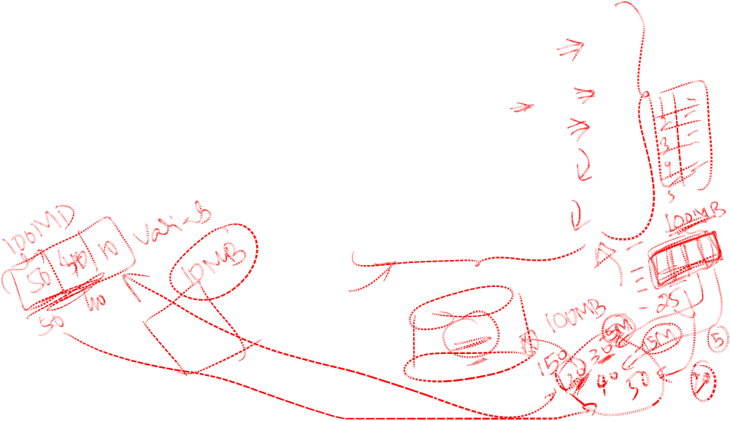
System Issues: How to Build a DBMS
Query Optimization
and Execution
Discussed so far
Relational Operators
Files and Access Methods
New topic
Buffer Management
Disk Space Management
DB

Slide 4
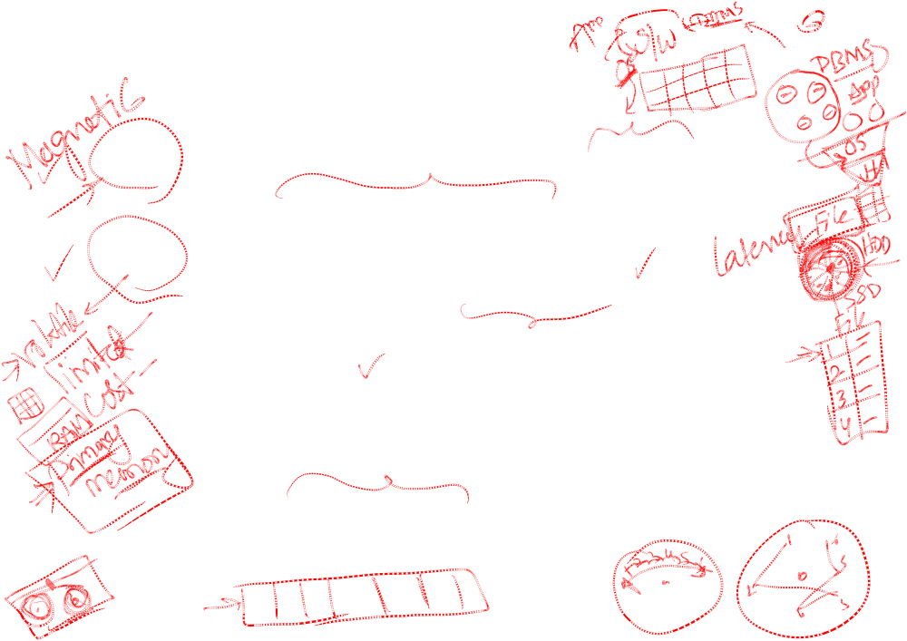
Data on External Storage
Disks: Can retrieve random page at fixed cost
  But reading several consecutive pages is much cheaper than reading them in random order
Tapes: Can read pages only in sequence
  Cheaper than disks; used for archival storage
File organization: Method of arranging a file of records on external storage.
  Record id (rid) is sufficient to physically locate record
  Indexes are data structures that allow us to find the record ids of records with given values in index search key fields
Architecture: Buffer manager stages pages from external storage to main memory buffer pool. File and index layers make calls to the buffer manager.
Notes:
Disks read 1 page at a time. We’ll come back to this.
Rid is enough to find page containing record.

Slide 5
Alternative File Organizations
Many alternatives exist, each ideal for some situations, and not so good in others:
  Heap (random order) files: Suitable when typical access is a file scan retrieving all records.
  Sorted Files: Best if records must be retrieved in some order, or only a `range’ of records is needed.
  Indexes: Data structures to organize records via trees or hashing.
    Like sorted files, they speed up searches for a subset of records, based on values in certain (“search key”) fields
    Updates are much faster than in sorted files.
Notes:
2
Relation is typically stored as a file of records (= tuples)
A file corresponds to several pages
Page size is typically 4KB – 8KB.
Sorted files: can sort on only one order.

Slide 6
Indexes
An index on a file speeds up selections on the search key fields for the index.
  Any subset of the fields of a relation can be the search key for an index on the relation (e.g., age or colour).
  Search key is not the same as key (minimal set of fields that uniquely identify a record in a relation).
An index contains a collection of data entries, and supports efficient retrieval of all data entries k* with a given key value k.
Example of Index: Essentials of Game Theory
Notes:
7
Can find record id from data entry. Like index in a book.
http://en.wikipedia.org/wiki/Indexing_Society_of_Canada

Slide 7
Alternatives for Data Entry k* in Index
Three alternatives:
  Data record with key value k
  <k, rid of data record with search key value k>
  <k, list of rids of data records with search key k>
Notes:
8

Slide 8
Alternatives for Data Entries (Contd.)
Alternative 1:
  If this is used, index structure is a file organization for data records (instead of a Heap file or sorted file).
  At most one index on a given collection of data records can use Alternative 1. (Otherwise, data records are duplicated, leading to redundant storage and potential inconsistency.)
  If data records are very large, # of pages containing data entries is high. Implies size of auxiliary information in the index is also large, typically.
Notes:
9

Slide 9
Example of Alternative 1
Loca-
tion
shape
colour
holes
6 data entries, sorted by colour
1
round
Red
2
2
square
Red
4
3
rectangle
Red
8
4
round
blue
2
5
square
blue
4
6
rectangle
blue
8

Slide 10
Example of Alternative 2
Loca-
tion
colour
6 data entries, sorted by colour
1
Red
2
Red
3
Red
4
blue
5
blue
6
blue

Slide 11
Example of Alternative 3
Loca- tions | colour
1, 2, 3 | Red
4,5,6 | Blue
2 data entries, variable lenth

Slide 12
Alternatives for Data Entries (Contd.)
Alternatives 2 and 3:
  Data entries typically much smaller than data records. So, better than Alternative 1 with large data records, especially if search keys are small. (Portion of index structure used to direct search, which depends on size of data entries, is much smaller than with Alternative 1.)
  Alternative 3 more compact than Alternative 2, but leads to variable sized data entries even if search keys are of fixed length.
Notes:
10

Slide 13
Index Classification
Primary vs. secondary: If search key contains primary key, then called primary index.
  Unique index: Search key uniquely identifies record.
Clustered vs. unclustered: If order of data records is the same as, or `close to’, order of data entries, then called clustered index.
  Alternative 1 implies clustered; in practice, clustered also implies Alternative 1 (since sorted files are rare).
  A file can be clustered on at most one search key.
  Cost of retrieving data records through index varies greatly based on whether index is clustered or not!
Notes:
11
Illustrate with data records being sorted by colour or not. Also show next overhead at the same time. Also illustrate with phone book analogy (Are phone books clustered on name? – answer yes. Are they clustered by phone number? Answer no.

Slide 14
Clustered vs. Unclustered Index
Suppose that Alternative (2) is used for data entries, and that the data records are stored in a Heap file.
  To build clustered index, first sort the Heap file (with some free space on each page for future inserts).
  Overflow pages may be needed for inserts. (Thus, order of data recs is `close to’, but not identical to, the sort order.)
Index entries
UNCLUSTERED
CLUSTERED
direct search for
data entries
Data entries
Data entries
(Index File)
(Data file)
Data Records
Data Records
Notes:
12

Slide 15
Hash-Based Indexes
Good for equality selections.
    Index is a collection of buckets. Bucket = primary page plus zero or more overflow pages.
    Hashing function h: h(r) = bucket in which record r belongs. h looks at the search key fields of r.
If Alternative (1) is used, the buckets contain the data records; otherwise, they contain <key, rid> or <key, rid-list> pairs.
Notes:
2
Illustrate with blocks. One bucket (page) per colour. Hash function: Red -> 1, Blue -> 2.
See figure 8.2 in text.

Slide 16
B+ Tree Indexes
Non-leaf
Pages
Leaf
Pages
Leaf pages contain data entries, and are chained (prev & next)
Non-leaf pages contain index entries; they direct searches:
index entry
P
K
P
K
P
K
P
m
0
1
1
2
2
m
Notes:
4
B+ trees “freeze” binary search.

Slide 17
Example B+ Tree
Root
17
Entries <= 17
Entries > 17
5
13
27
30
2*
3*
5*
7*
8*
14*
16*
22*
24*
27*
29*
33*
34*
38*
39*
Find 28*? 29*? All > 17* and < 30*
Insert/delete: Find data entry in leaf, then change it. Need to adjust parent sometimes.
  And change sometimes bubbles up the tree
Notes:
15

Slide 18
Cost Model for Our Analysis
We ignore CPU costs, for simplicity:
  B: The number of data pages
  R: Number of records per page
  D: (Average) time to read or write disk page
  Average-case analysis; based on several simplistic assumptions.
  Good enough to show the overall trends!
Notes:
3

Slide 19
Comparing File Organizations
Heap files (random order; insert at eof)
Sorted files, sorted on <age, sal>
Clustered B+ tree file, Alternative (1), search key <age, sal>
Heap file with unclustered B + tree index on search key <age, sal>
Heap file with unclustered hash index on search key <age, sal>
Notes:
Illustrate organizations with blocks as much as possible.

Slide 20
Operations to Compare
Scan: Fetch all records from disk
Equality search (e.g., “age = 30”)
Range selection (e.g., “age > 30”)
Insert a record
Delete a record
Parameters of the Analysis
 | B = # data pages | R = #records/page | D = disk page I/O time | C = process single record | H = apply Hash function | F = index tree fan-out
Typical value |  |  | 15 mlsec | 100 nanosec | 100 nanosec | 100
Notes:
Illustrate with Records.

Slide 21
Assumptions in Our Analysis
Heap Files:
  Equality selection on key; exactly one match.
Sorted Files:
  Files compacted after deletions.
  Clustered files: pages typically 67% full.
  Total number pages needed = 1.5 B.
Indexes:
  Alt (2), (3): data entry size = 10% size of record
  Hash: No overflow buckets.
    80% page occupancy.
    Index size = 1.25 B data size.
    #data entries/page = 10 (0.8R) = 8R.
  Tree: 67% page occupancy of index pages (this is typical).
    #leaf pages = (1.5 B) 0.1 = 0.15 B.
    #data entries/page = 10 (0.67R) = 6.7R.
Notes:
4
Compacted after deletion: move up records to close free space. Necessary because there is no easy way to manage free space.
File size is number of pages in file.
Nano = 10^-9

Slide 22
Scanning Cost
Heap file: B(D + RC).
  for each page (B)
  Read the page (D)
  For each record (R), process the record (C).
Sorted File: B(D + RC).
  Have to go through all pages.
Clustered File: 1.5B (D+RC).
  Pages only 67% full.
Unclustered Tree Index: >BR(D+C). Bad!
    for each record (BR)
    retrieve page and find record (D + C).

Slide 23
Exercise for Group Work
Estimate how long an equality search takes in
(i) a heap file (ii) a sorted file (iii) a hash file, hashed on the search key, with at most one record matching the search key (i.e., the search is on a key field).
2. Estimate how long an insertion takes in
(i) a heap file (ii) a sorted file (iii) a hash file.
 | B = # data pages | R = #records/page | D = disk page I/O time | C = process single record | H = apply Hash function | F = index tree fan-out
Typical value |  |  | 15 msec | 100 nanosec | 100 nanosec | 100

Slide 24
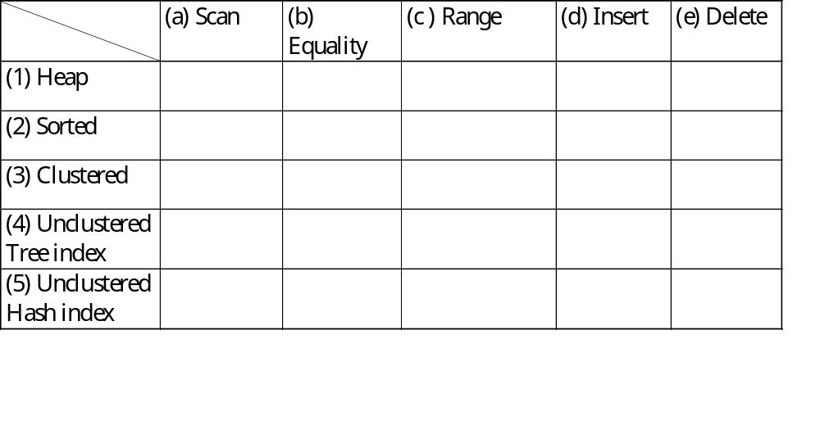
Cost of Operations
Several assumptions underlie these (rough) estimates!
Notes:
5
Show GUI for index in DBMS.

Slide 25
Index Illustrations
Hash Insertion: 4 D I/Os: 2 to read/write data page, 2 to read/write index entry.
Hash Index Illustration.
Clustered Tree Index Illustration.

Slide 26
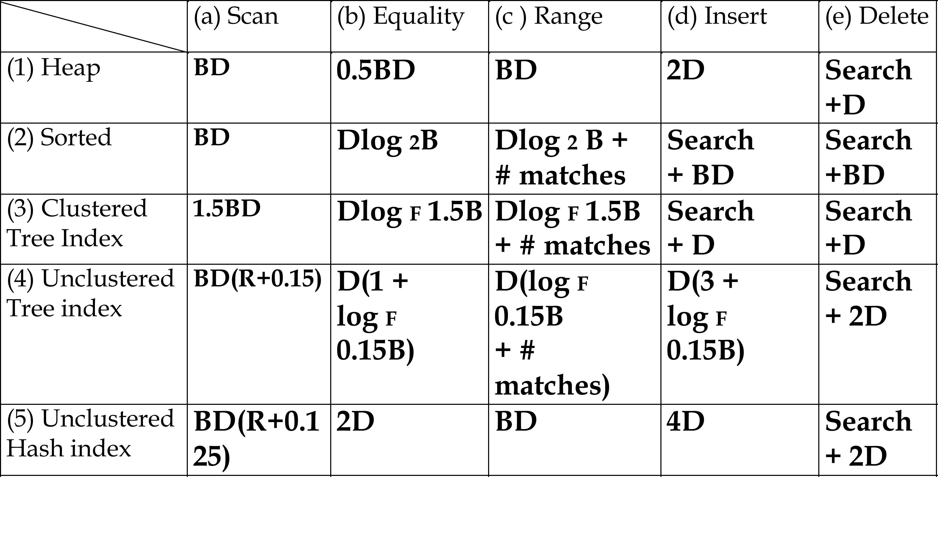
I/O Cost of Operations
Several assumptions underlie these (rough) estimates!
Order of magnitude results.
Notes:
5
Has index insert: need 2D to find and write data page, 2D to find and write index page.
Log_F(0.15 B) for finding leaf page in the index.

Slide 27
Create Indexes in SQL-Server
SQL Server supports many options for creating indices (more than we can cover).
Sample Syntax:
use aworks;
create index IX_Product_Color
on SalesLT.Product (Color);
More Examples

Slide 28
Understanding the Workload
For each query in the workload:
  Which relations does it access?
  Which attributes are retrieved?
  Which attributes are involved in selection/join conditions? How selective are these conditions likely to be?
For each update in the workload:
  Which attributes are involved in selection/join conditions? How selective are these conditions likely to be?
  The type of update (INSERT/DELETE/UPDATE), and the attributes that are affected.
Notes:
11

Slide 29
Choice of Indexes
What indexes should we create?
  Which relations should have indexes? What field(s) should be the search key? Should we build several indexes?
For each index, what kind of an index should it be?
  Clustered? Hash/tree?
Notes:
12

Slide 30
Choice of Indexes (Contd.)
One approach: Consider the most important queries in turn. Consider the best plan using the current indexes, and see if a better plan is possible with an additional index. If so, create it.
  Obviously, this implies that we must understand how a DBMS evaluates queries and creates query evaluation plans!
  For now, we discuss simple 1-table queries.
Before creating an index, must also consider the impact on updates in the workload!
  Trade-off: Indexes can make queries go faster, updates slower. Require disk space, too.
Notes:
13

Slide 31
Index Selection Guidelines
Attributes in WHERE clause are candidates for index keys.
  Exact match condition suggests hash index.
  Range query suggests tree index.
    Clustering is especially useful for range queries; can also help on equality queries if there are many duplicates.
Multi-attribute search keys should be considered when a WHERE clause contains several conditions.
  Order of attributes is important for range queries.
  Such indexes can sometimes enable index-only strategies for important queries.
    For index-only strategies, clustering is not important!
Try to choose indexes that benefit as many queries as possible. Since only one index can be clustered per relation, choose it based on important queries that would benefit the most from clustering. MS Index Tuning Wizard
Notes:
14
Relate exact match and range query performance back to performance table.
Index-only strategy: answer question using data entries only. Often works for aggregation, e.g. count* (see below). Give example of product color from assignment, retrieve all colors.

Slide 32
Examples of Clustered Indexes
SELECT E.dno
FROM Emp E
WHERE E.age>40
B+ tree index on E.age can be used to get qualifying tuples.
  How selective is the condition?
  Is the index clustered?
Consider the GROUP BY query.
  If many tuples have E.age > 10, using E.age index and sorting the retrieved tuples may be costly.
  Clustered E.dno index may be better!
Equality queries and duplicates:
  Clustering on E.hobby helps!
SELECT E.dno, COUNT (*)
FROM Emp E
WHERE E.age>10
GROUP BY E.dno
SELECT E.dno
FROM Emp E
WHERE E.hobby=Stamps
Notes:
18

Slide 33
Index-Only Plans
SELECT D.mgr
FROM Dept D, Emp E
WHERE D.dno=E.dno
<E.dno>
A number of queries can be answered without retrieving any tuples from one or more of the relations involved if a suitable index is available.
SELECT D.mgr, E.eid
FROM Dept D, Emp E
WHERE D.dno=E.dno
<E.dno,E.eid>
Tree index!
SELECT E.dno, COUNT(*)
FROM Emp E
GROUP BY E.dno
<E.dno>
SELECT E.dno, MIN(E.sal)
FROM Emp E
GROUP BY E.dno
<E.dno,E.sal>
Tree index!
<E. age,E.sal>
or
<E.sal, E.age>
SELECT AVG(E.sal)
FROM Emp E
WHERE E.age=25 AND
E.sal BETWEEN 3000 AND 5000
Tree!
Notes:
21
In top query, don’t need to retrieve E tuples. In 2nd query, don’t need to retrieve E tuples either.

Slide 34
Summary
Many alternative file organizations exist, each appropriate in some situation.
If selection queries are frequent, sorting the file or building an index is important.
  Hash-based indexes only good for equality search.
  Sorted files and tree-based indexes best for range search; also good for equality search. (Files rarely kept sorted in practice; B+ tree index is better.)
Index is a collection of data entries plus a way to quickly find entries with given key values.
Notes:
14

Slide 35
Summary (Contd.)
Data entries can be actual data records, <key, rid> pairs, or <key, rid-list> pairs.
  Choice orthogonal to indexing technique used to locate data entries with a given key value.
Can have several indexes on a given file of data records, each with a different search key.
Indexes can be classified as clustered vs. unclustered, and primary vs. secondary. Differences have important consequences for utility/performance.
Notes:
15
Original had “dense” vs. “sparse” – perhaps look in Ullman?

Slide 36
Summary (Contd.)
Understanding the nature of the workload for the application, and the performance goals, is essential to developing a good design.
  What are the important queries and updates? What attributes/relations are involved?
Indexes must be chosen to speed up important queries (and perhaps some updates!).
  Index maintenance overhead on updates to key fields.
  Choose indexes that can help many queries, if possible.
  Build indexes to support index-only strategies.
  Clustering is an important decision, demanding on DBMS but potentially high payoff.
Notes:
Work-around for last point, e.g. in SQL server: create views on table, index view.
Comments on column storage, key-value.

